Slide 1
Managing Federal Receivables:
Collecting, Reporting and Analytics
Centralized Receivables Service and the
Financial Information Repository
Jeffrey Schramek
Dan Keenaghan
May 9, 2016

Slide 2

Agenda
DMS Mission, Vision and Role
CRS Description
CRS Mission
CRS Benefits, Highlights and Features
CRS Performance Results
CRS Portal Overview
Sample Implementation Timeline
FIR Overview
Private Portal Overview
Upcoming Enhancements

Slide 3
DMS Mission and Vision
Mission: To identify, prevent, collect and resolve debt owed to government agencies.
Vision: To transform government financial management as the provider of choice for services related to improper payments, receivables management and delinquent debt collection.

Slide 4
DMS Role
DMS assists federal agencies in preventing receivables related to improper payments through the Do Not Pay (DNP) Business Center, collecting and resolving current receivables through the Centralized Receivables Service (CRS) pilot, and collecting delinquent, non-tax federal debts through Treasury Offset Program (TOP) and Cross-Servicing.
We also assist the Office of Child Support Enforcement with collecting delinquent child support debts, the Internal Revenue Service with collecting delinquent tax debts through continuous levy of federal payments, and state governments with the collection of delinquent state income tax debts and other state debt.

Slide 5
The Centralized Receivables Service (CRS)

Slide 6
The Centralized Receivables Service (CRS)
Invoice automation including demand letter and due process notice
Offers electronic and conventional remittance options
Active debtor location through skiptracing and outbound calls
Call center servicing
Automated referral to Treasury for delinquent servicing
Standardization and DATA Act compliance

Slide 7
CRS Background
In 2012, Treasury completed a study to assess cost/benefits of centralizing receivables government-wide
Results were favorable, and Treasury’s Office of Financial Innovation and Transformation (FIT) partnered with Fiscal Service’s Debt Management Services (DMS) to pilot the CRS program
DMS partnered with a Financial Agent and established a Financial Agent Agreement for three years, with two optional one-year extension terms
CRS went live on December 31, 2012 and began servicing accounts receivable in January 2013

Slide 8

CRS Mission
The Centralized Receivables Service (CRS) is a service provided at no charge to federal agency programs to assist in the management of current, non-tax receivables. CRS increases collections and prevents delinquencies while allowing agencies to focus on important core missions.
Notes:
In 2012, the Fiscal Assistant Secretary commissioned a McKinsey study through the Office of Financial Innovation and Transformation (FIT) to assess cost/benefits of centralizing receivables government-wide
Results were favorable, and FIT partnered with Treasury’s Fiscal Service Debt Management Service (DMS) division to pilot the CRS program
DMS partnered with a Financial Agent and established a Financial Agent Agreement for three years, with two optional one-year extension terms
CRS went live on December 31, 2012 and began servicing accounts receivable in January 2013

Slide 9
CRS Benefits-Cheaper, Faster, Better…
Increased Collections
Increases collectability and decreases delinquencies through prompt servicing and invoicing
Ensures quality and compliance with Debt Collection Improvement Act (DCIA), the Data Act of 2014, Federal Claims Collections Standards (FCCS) and the government-wide all electronic initiative
Offers state-of-the-art receivables management with customizable options in an automated and paperless environment that deliver exceptional customer service
Provides full access to case management, history and reports
Reduces costs through economies of scale in an automated business environment. No cost to agencies in short term and planned legislation for long term to keep CRS at no cost to agencies
Reduced Costs
Standardization & Compliance
CRS
Transparency
Customer Service

Slide 10
CRS Services and Functionality
Services Offered
Implementation support
Business process modeling
Agency training
Invoicing
Installment agreements
Account resolution for death, bankruptcy and entity out of business
Full service call center / inbound and outbound
Returned mail processing and skiptracing
Payment collections
Case history management
Transfer of delinquent debt to DMS Cross-Servicing
Functionality Offered
Collections Information Repository (CIR), Cross Servicing, and agency interfaces
User-friendly reports
Case file with complete case history
Configurable collection parameters
Variety of payment collection options
Portal (online) and batch transmission for case referrals
Batch adjustments and batch attachments to update case information
Master case (multiple cases under one case)
Joint and several debtors (2 or more debtors each 100 percent liable for the same debt)

Slide 11
CRS Receivable Life Cycle
Day 0:
Agency uploads receivables to CRS via batch or web portal entry
Day 1:
CRS automatically generates and mails invoice with due process notifications
Days 2-30:
Debtor makes payment using established collection channels
Payments are posted to agency ALC via CIR
Debtor can call CRS to ask questions, dispute debt, or enter into an installment agreement
Day 31:
Past due notice is automatically generated and mailed out
CRS system begins to apply interest to the principal
Day 32-60:
Collections activities begin: daily phone calls, skiptracing, etc.
Debtor can continue making payments using established collection channels
Day 65:
CRS refers case to Treasury Cross-Servicing (FedDebt)

Slide 12
CRS Performance Results
Current receivables portfolio is more than 81,927 cases
Collections exceed $54 million
FY 2015 collection rate of 63.1 percent
Average number of days of receivables paid in full is 35
99 percent of inbound calls answered in under 2 minutes
47 agency programs participating

Slide 13
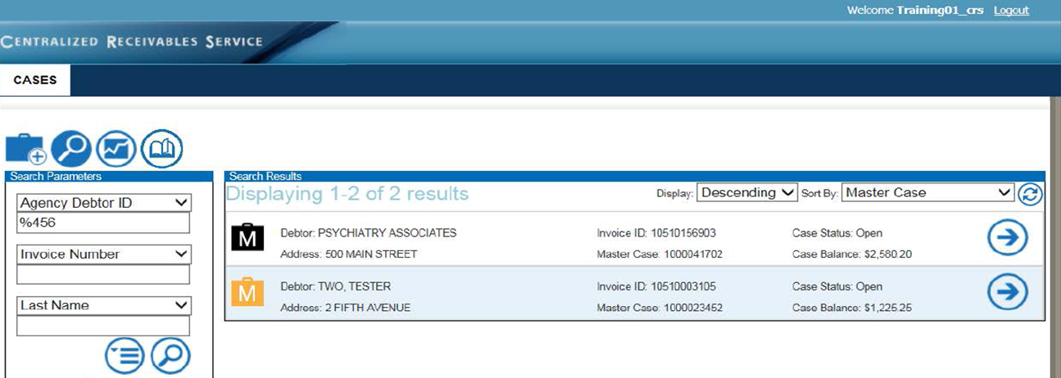
CRS Portal Overview
User friendly web display with icons
Simple searchable web application
Color-coded cases status
Filterable search criteria and results

Slide 14
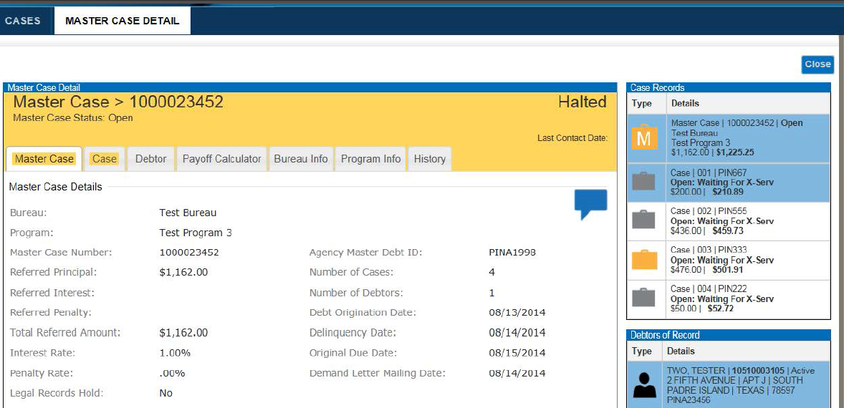
CRS Portal Overview
Complete virtual case files and reports
Master Case (Itemization) Sub Case Summary views
Agency users can view any aspect of a case at any time
Demand and Due Process Letters and other case attachments

Slide 15
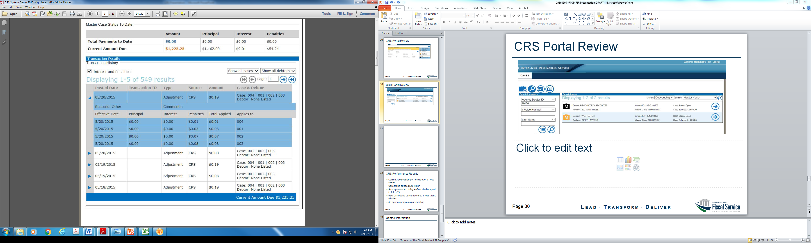
CRS Portal Overview
Tab and filter tools allow users to quickly view master and sub-case itemized details:
View case adjustments
View case totals
View interest and penalty assessments

Slide 16
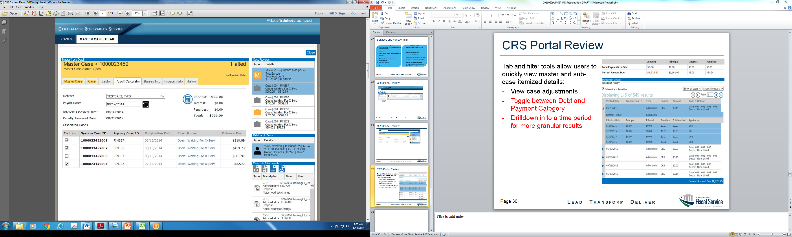
CRS Portal Overview
Payoff Calculator feature allows servicing agents to provide real-time payoff data to customers who would like case information when paying over the phone
This feature provides for greater efficiencies in servicing time and helps to ensure greater collection activity per call
Payoff calculator can calculate full master case payoff amounts or provide amounts by any selection of subcases

Slide 17
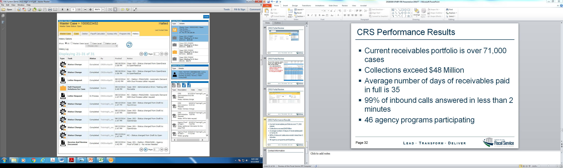
CRS Portal Overview
Case history tab allows for full transparency and audit readiness
All case activity is date stamped with system and user updates
All documents are stored and saved for 7 years.

Slide 18
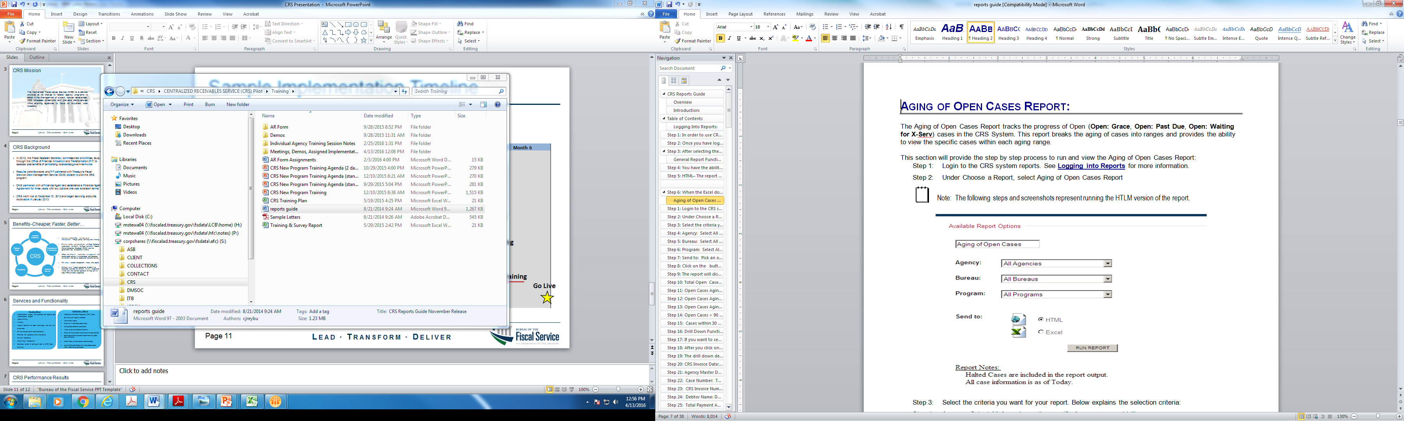
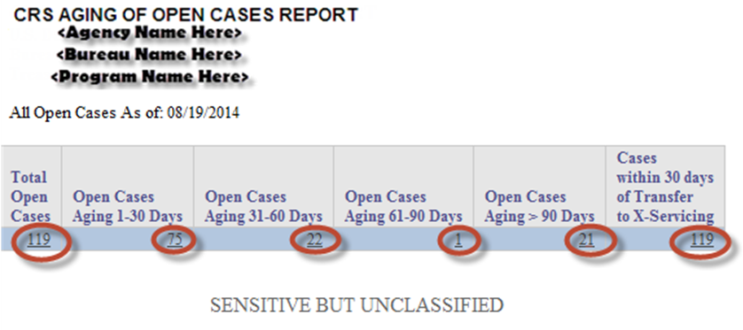
CRS User and Reports Guide

Slide 19
Sample Implementation Timeline
Month 1 | Month 2 | Month 3 | Month 4 | Month 5 | Month 6
Information Gathering
Develop Agency Profile
Establish Collection Channels
Agency/CRS Signoff
User Credentialing
Set up Batch File Transfer (if needed)
Testing
Training
Go Live

Slide 20
The Financial Information Repository (FIR)
Analyzing Your Federal Receivables:
- Access to the Receivables Data Reported in the
Treasury Report on Receivables
- Access to the Treasury Offset Program and
Cross-Servicing Data

Slide 21

FIR Overview
Transparency
Accountability
Improved Decision Making
Operational Efficiency
Notes:
FIR Overview
- The purpose of FIR is to provide a single touch-point for financial management information to improve transparency and accountability within the federal government
- The FIR supports the transparency and accountability objectives of the federal government by making financial reporting and analysis more easily accessible.
- Information is provided through interactive reports, dashboards, and visualizations that will expand over time
- Provide insight and access to information for data trends and pattern analysis to enable improved agency decision making and operational efficiency
Promotes operational efficiency by:
- Providing insight into financial data for improved agency decision making
- Providing a single, integrated system to query data and view reports
- Robust and intuitive web front-end for analyzing data trends and patterns
Other:
- Two major releases implemented in 2015, with three additional releases in 2016 (one already completed). The team is moving to a cadence of three releases per year.
- Releases to data have been focused on setting up the infrastructure, UI, and various connectivity and reporting opportunities with Fiscal Service business lines.

Slide 22

What is the FIR?
Application that manages and integrates federal financial information to authorized users in a single location
Notes:
Promotes operational efficiency by:
- Providing insight into financial data for improved agency decision making
- Providing a single, integrated system to query data and view reports
- Robust and intuitive web front-end for analyzing data trends and patterns

Slide 23

What data is in the FIR?
The FIR supports through two portals (Public and Private) transparency and accountability and promotes operational efficiency by providing secure access to the following data:
Debt Management
Payments
Collections
Accounting
Notes:
Promotes operational efficiency by:
- Providing insight into financial data for improved agency decision making
- Providing a single, integrated system to query data and view reports
- Robust and intuitive web front-end for analyzing data trends and patterns

Slide 24

What drives the FIR?
Technology
Agency Goals
&
Objectives
Agency
Feedback
Transparency
Technology
Repositories
(Data Sets)
Notes:
Clearly, there are multiple factors that contribute to the development of the FIR. As you can see, the largest (and most important/influential) is agency/user feedback.
Every time an agency provides feedback, it is provided to our development team to drive future technology. There are different ways that we use feedback, such as:
Enhancements to the portal
Guiding future data prioritization
Improve processes for onboarding
As our Outreach Team continues to build relationships with agencies, we will be asking more probing questions.

Slide 25
Public and Private Portals of the FIR
Public Portal
Provides summary level information of federal agencies’ data
Debt management data available in the public portal:
Treasury Offset Collections (Child Support, Income Tax, SNAP, State Reciprocal, and UIC)
Treasury Report on Receivables (TROR) Data
Private Portal
Provides summary and program detail level information of federal agencies’ data
Provides same debt management data as the Public Portal for Treasury Offset Collections and TROR data, but allows the user to drill down to the program level

Slide 26
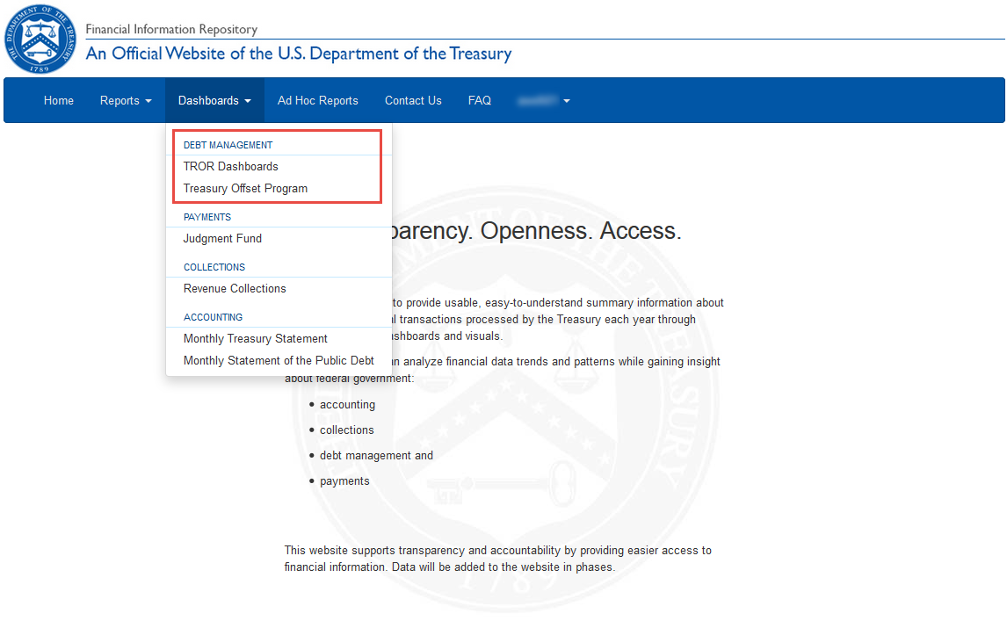
Private Portal Overview
Dashboards provide a high-level interaction view of data from Debt Management, Payments, Collections and Accounting business lines.
The dashboard options you see will vary based on your access rights.

Slide 27
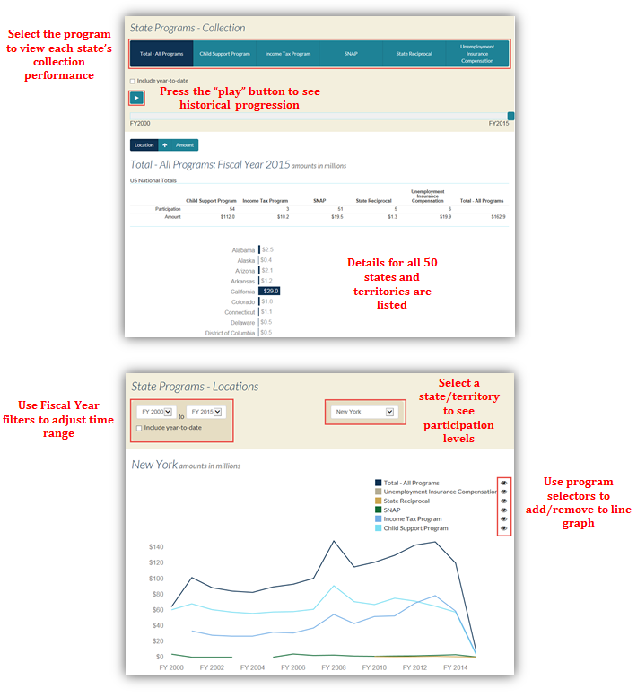
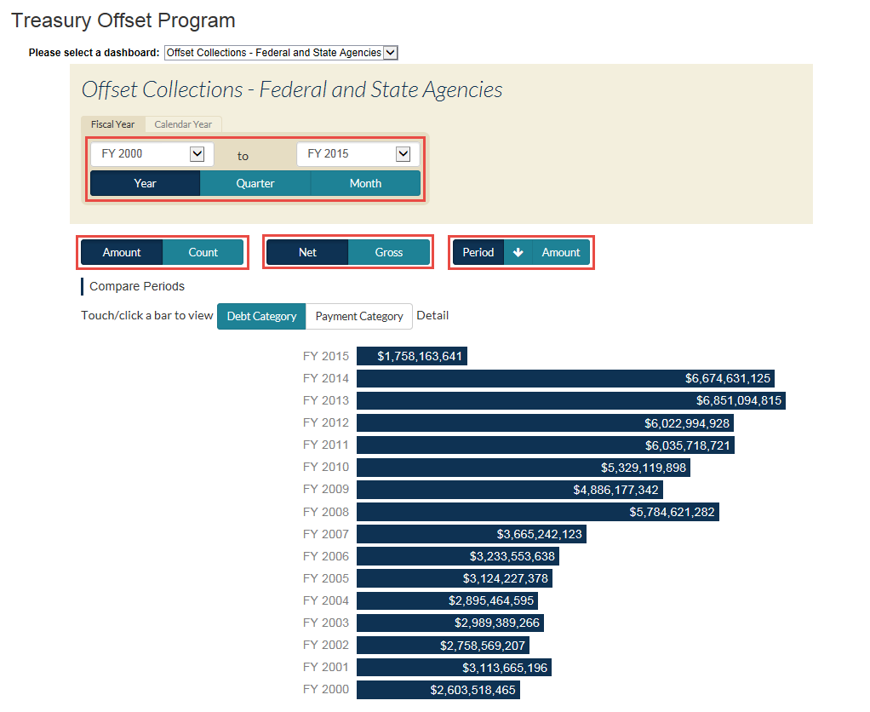
Private Portal Overview
Various filters and options allow for easy access and data analysis.

Slide 28
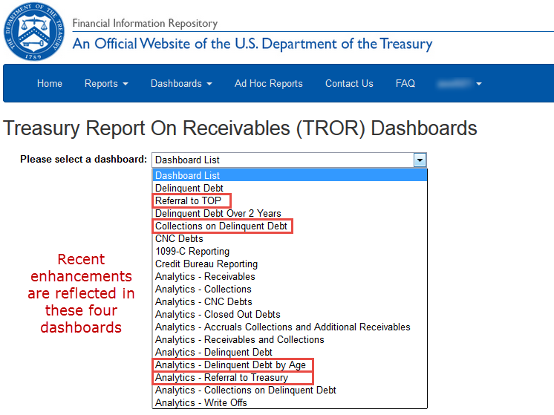
Private Portal Overview
Enhancements to the TROR Dashboards allow user to view interactive detail regarding DATA Act reporting requirements provided through the TROR.

Slide 29
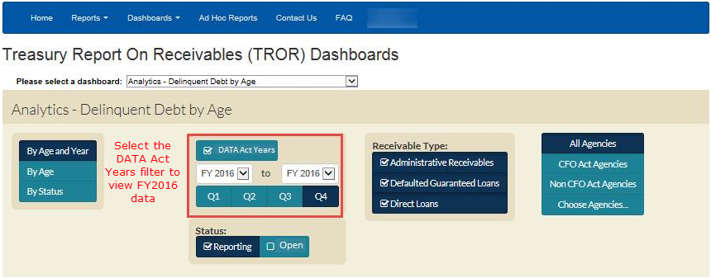
Private Portal Overview
Analytics - Delinquent Debt by Age dashboard allows you to apply a simple filter to view quarterly data both before and after the new DATA Act referral requirement.

Slide 30
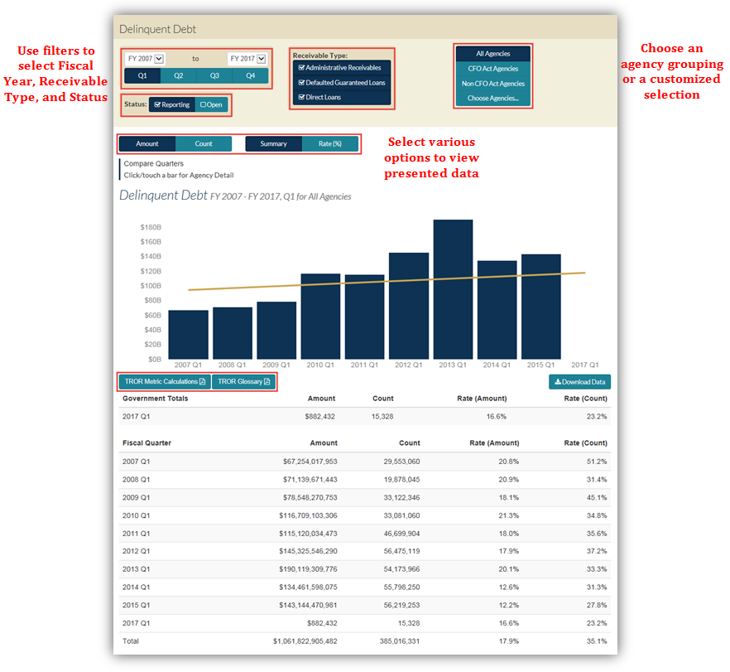
Private Portal Overview
After choosing one of the 18 dashboards, data will populate with these default selections:
FY2007 – Most Recent Fiscal Period
Reporting Status
All Agencies
All Receivable Types
Data for the same Fiscal Quarter is presented in a bar graph and table.
Use the Download Data button to access the table beneath the graph.
Drill into a specific Fiscal Period’s data from this initial page and the same functionality carries through as you drill into lower levels of data.
Drill down into Agency, Bureau, and Entity detail levels by clicking on a Fiscal Period bar

Slide 31
Contact Information
FIR: Primary Contact
Terrence Prince
Manager, Portfolio Management Analysis Branch
202-874-9893
terrence.prince@fiscal.treasury.gov
Secondary Contact
Richard Gassaway
Director, Data Management, Reporting & Analysis Division
202-874-9893
richard.gassaway@fiscal.treasury.gov
CRS: Primary Contact
Lamar Sutton
CRS Customer Outreach, DMS, Treasury
(202) 874-5203
CRSOutreach@fiscal.treasury.gov
Secondary Contact
Michael Stewart, Jr.
CRS Outreach and Implementation Supervisor, DMS, Treasury
(202) 874-7457
CRSOutreach@fiscal.treasury.gov
Web site: https://fiscal.treasury.gov/crs

